Slide 1

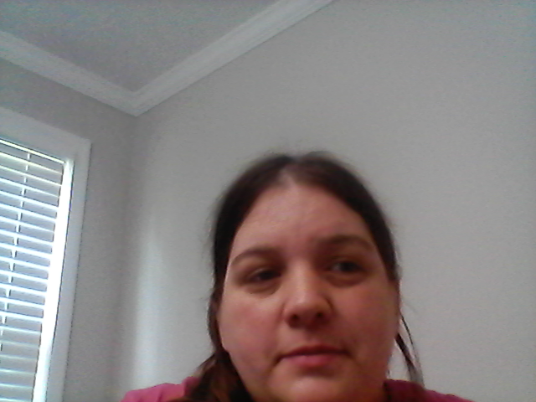
Pre-k orientation 2021-2022
Pre-k Teachers

Slide 2

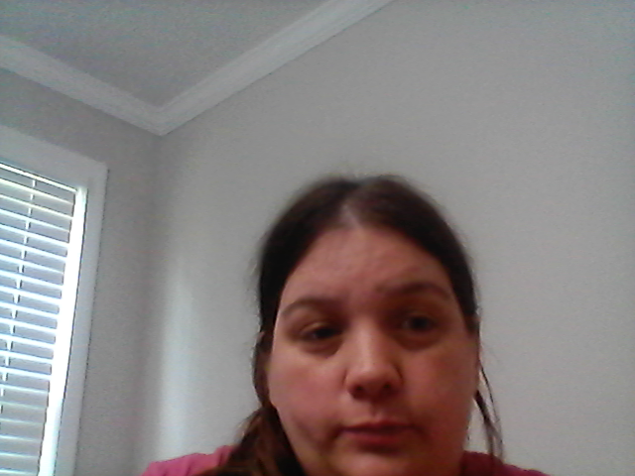
Daily Routine
School Day: 8:15AM -3:15PM.
Your Student is considered tardy after 8:15AM
Parents CANNOT pick a student up after 2:30PM.

Slide 3

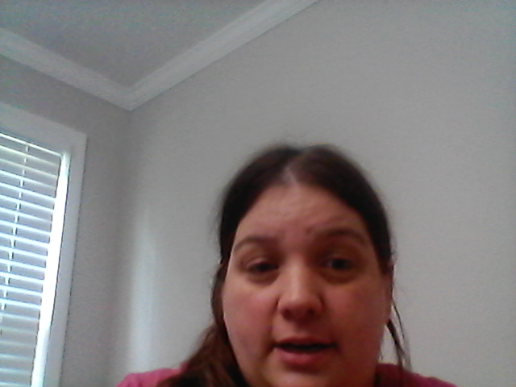
Change of Transportation?
Please write a note if your student is going home a different way.
We are not allowed to take phone calls unless it is an absolute emergency.

Slide 4

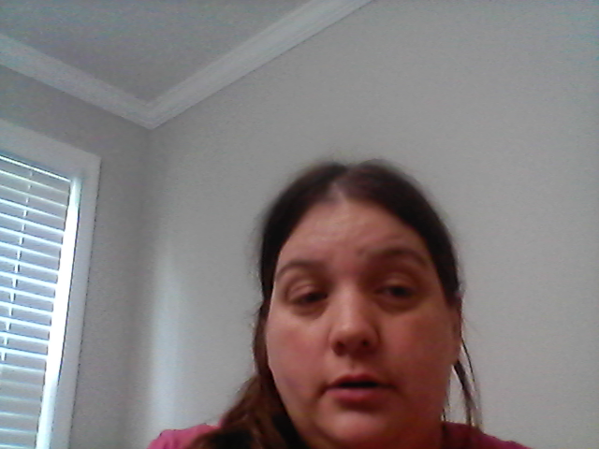
Car Riders
Drop off/ Dismissal:
Drop off and Dismissal is in the back of the school.
Drop off starts at 7:45AM
Dismissal begins at 2:55PM.
*Do not get out of your car*
Car Tags:
Required to pick up your student at dismissal.
NO car tag, NO student.
* Extra car tags can be purchased for $2.00 in front office.

Slide 5


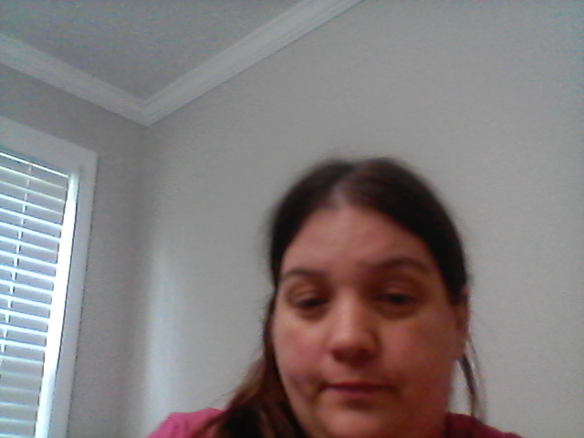
Required Documents
* Social Security Card, Form 3300 (immunization),
Due: September 7th, 2021
* Form 3231 (Ear, Eye, Dental, and Nutrition)
Due: November 8th, 2021
Failure to turn these documents in could have your student withdrawn from school/program.

Slide 6

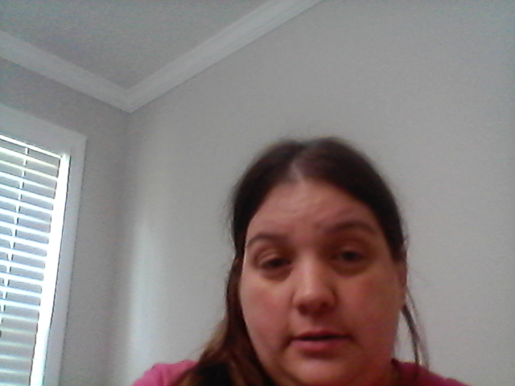
Early Release Dates
Thursday, October 7th, 2021
Tuesday, December 21th, 2021
Friday, February 18th, 2022
Thursday, March 10th, 2022
Tuesday, May 24th, 2022 LAST DAY OF SCHOOL

Slide 7

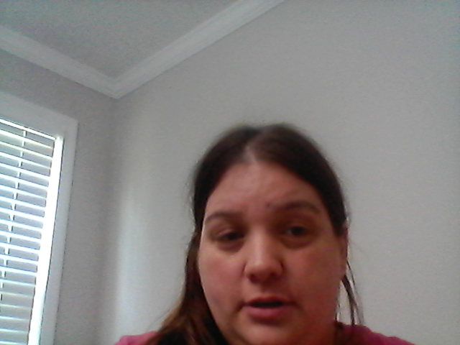
No school dates
Labor Day- September 6th, 2021
Fall Break- October 8th-October 11th
Veterans Day- November 11th, 2021
Thanksgiving Break- November 22-26
Christmas/ Winter Break- Dec 22 –31 2021
Student Holiday- January 3rd, 2022
MLK Holiday- January 17th, 2022
Student Holiday- February 18th, 2022
Student Holiday- February 21st, 2022
Student Holiday- March 11th, 2022
Spring Break- April 4th-11th, 2022
Student Holiday- April 15th, 2022

Slide 8

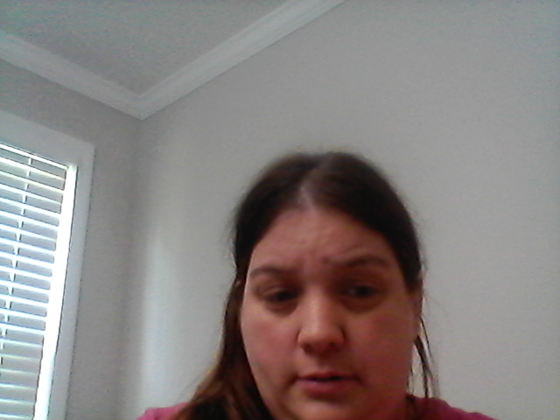
Tardies
Chronic Tardiness is a late arrival or early departure more than once per week. Chronic Absenteeism is missing more than 2 days per month without medical or other reasonable excuse.

Slide 9

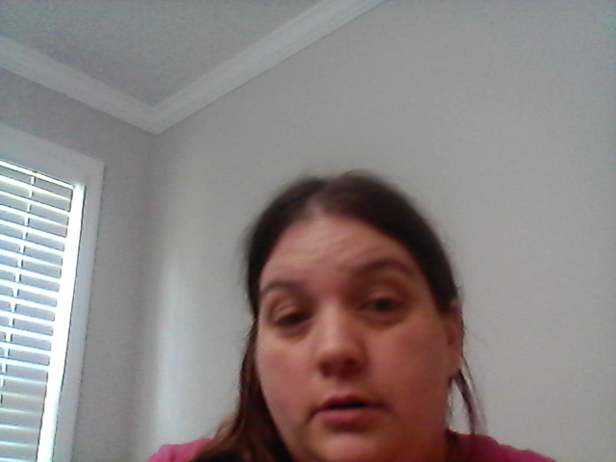
If your child is sick....
If your student has a fever, throwing up, and/or diarrhea please keep them home.
Your student has to be free from all symptoms for 24 HOURS before he/she is allowed back to school.
Please check for COVID symptoms daily.

Slide 10

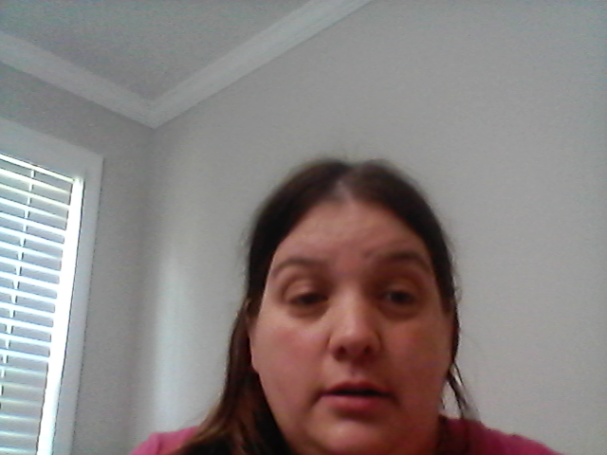
Snacks
We need donations; they will be greatly appreciated, no peanut products please.
They must be individually wrapped
* We have 22 student's total

Slide 11


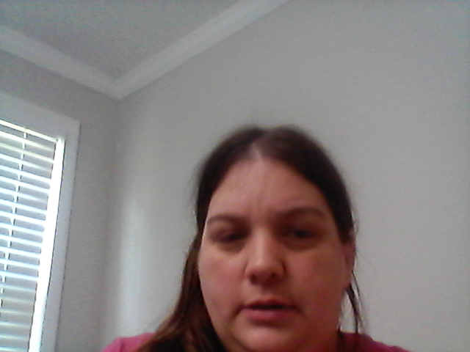
Join Class DOJO Or Remind
Mrs. Key's class
Mrs. Brown's Class
https://classdojo.com/invite/?c=C8E3SQ9

Slide 12

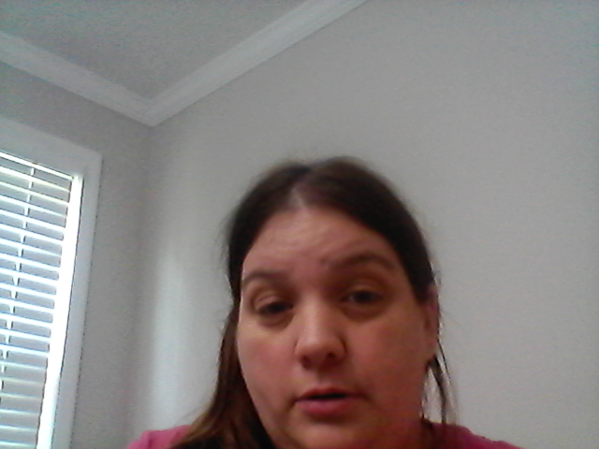
Parent Conferences
We do 2 conferences per school year
1. (Early December)
2. (Early-Mid May)

Slide 13
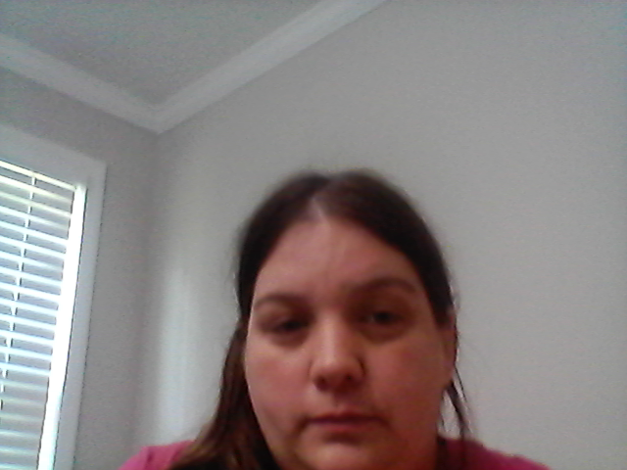
Contact Info
Ways to get in contact with the teacher
1. Write in your child's daily folder​
2. DOJO/ Remind message​
3. email- keyta@boe.richmondk12.ga.usBrownch@boe.richmond.k12.ga..us
4.Call school – 706-796-4969 and leave message

